Slide 1
MONEY TRANSFER WEBSITE
Task - 1

Slide 2

MONEY TRANSFER WEBSITE e
The purpose of this SRS is to outline both the functional and non-functional requirements of the subject money transfer system. The document also provides the detailed profile of the external interfaces, performance consideration and design constraints imposed on the subsequent implementation.
LMS Username | Name | Batch
2115a920 | GOKULA KRISHNAN A | A9
2115a921 | GOKULNATH K | A9
2115a941 | RAMVILAS H | A9
2115a930 | KARTHIKEYAN B | A9

Slide 3

1.Introduction
1.1 Purpose
1.2 Scope
1.3 Overview
2.Overall Description
2.1 Product prespective
2.2 Product Features
2.3 Product Function
3.Functional Requirements
4.Interface Requirements
4.1 User Interface
4.2 Hardware Interface
4.3 Software Interface
4.4 Communication Interface
5.Other non-functional Requirements
5.1 System Architecture
5.2 Safety Requirements
5.3 Security Requirements
5.4 Testing Requirements

Slide 4
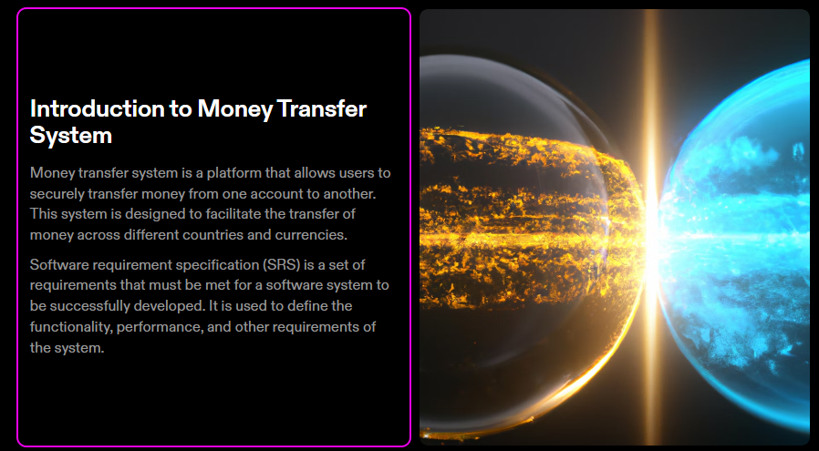

Slide 5

PURPOSE
The purpose of this SRS is to outline both the functional and non-functional requirements of the subject money transfer system. In addition to said requirements, the document also provides the detailed profile of the external interfaces, performance consideration and design constraints imposed on the subsequent implementation. The documents should act as a foundation for efficient and well managed project completion and further serve as an accurate reference in the future.
A money transfer service is an app, website or service that helps you digitally transfer money from one place to another. Learn the details of how different money transfer services work, how to send money internationally and more.

Slide 6

SCOPE:
The money transfer has a very wide scope
It is very inexpensive and reliable way of transfer and receives money. It helps us to transfer online money to anywhere in world in a very short time. Now days people don’t want to waste there their time in standing in bank’s queue and don’t have time to go to bank. Everyone wants to get the things done from where ever they are and whenever they want. So there is lots of scope for money transfer business. It is also a secure way of transfer and receives money.

Slide 7

Overview
A Funds Transfer is a sequence of events that results in the movement of funds from the remitter to the beneficiary. It is also defined as the remittance of funds from one party to itself or to another party through the banking system. It is an essential support function for other financial products such as loan repayment, settlement of trade bills etc., apart from being an important stand-alone function in a typical bank.

Slide 8

2.Overall description
Product perspective
The online Money transfer website is an application of web-based system. This website provide complete product to place review, transfer and fund processing. It can be accessed through internet browsers on PC, mobile etc.
Product features
It provides a E-Commerce business product for the restaurants and hotels to manage and boost their business online. Through this website application connect bankswith the customer within few clicks at the peak lunch time. This also helps to learn about the web application designing for eCommerce using new programming technique.

Slide 9
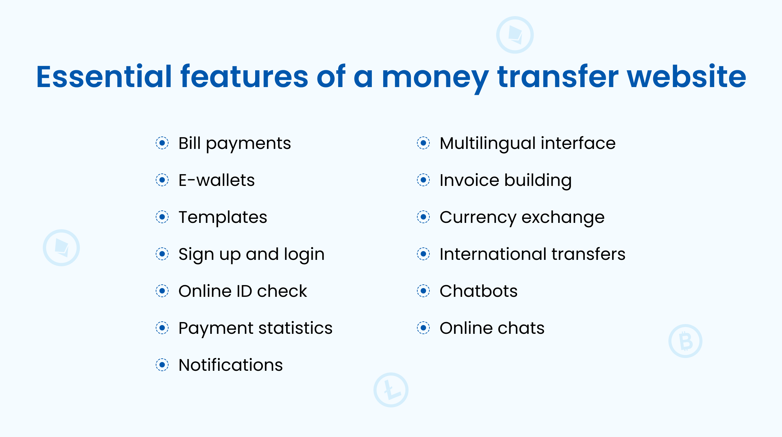
Product Features :

Slide 10
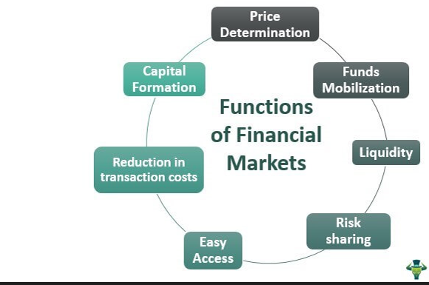
Product Functions :

Slide 11

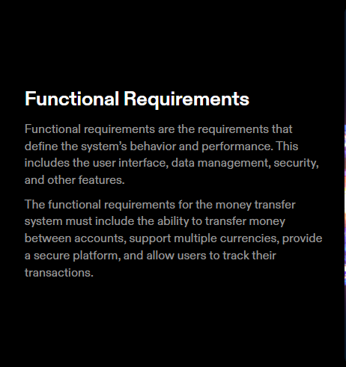

Slide 12
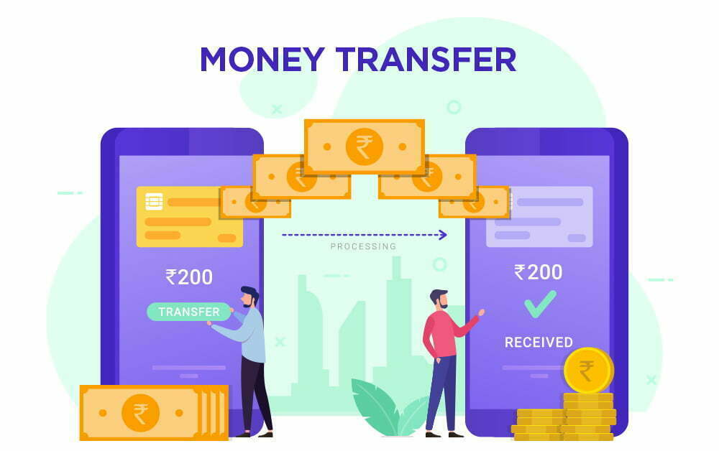
Interface requirements:
User Interfaces-
This interface uses the surface computer paradigm - users interact with the system by dragging 'objects' around on the ﬂatscreen touch-sensitive display. For the RFOS, users can manipulate objects such as money, transfer requirements, of their bank Such objects can be moved into static objects such aspayments to perform various functions. In addition to this object manipulation paradigm, a limited system is necessary. Users will summon their transaction, which is combined with a system/command requirements, using an easy touch gesture, a double-tap on the touch surface, and dismiss it with a similar gesture or by tapping a close button GUI element

Slide 13
Hardware Interfaces
These devices are the surface computers, the wireless tablets and the touch displays. All three devices must be physically robust and immune to liquid damage and stains.
The devices(with the possible exception of displays) must also have good industrial design aesthetics, as they are to be used in place of normal restaurant tables and banks and will be in direct contact with customers.

Slide 14
Software Interfaces
The RFOS will interface with a Database Management System (DBMS) that stores the information necessary for the RMOS to operate. The DBMS must be able to provide, on request and with low latency, data concerning the restaurant's menu, employees (and their passwords) and available dietary requirements

Slide 15
Communications Interfaces
The RFOS will interface with a Local Area Network (LAN) to maintain communication with all its devices. It should use a reliable-type IP protocol such as TCP/IP or reliable-UDP/IP for maximum compatibility and stability.
All devices it will interface with should contain standard Ethernet compatible, software accessible LAN cards to maintain communication between the server and the surface computers, tablets, displays and the external payment system.

Slide 16
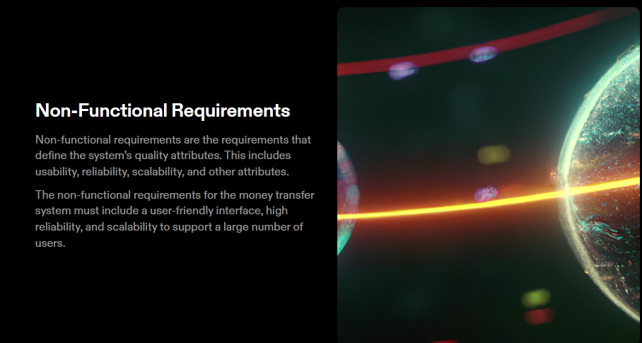

Slide 17

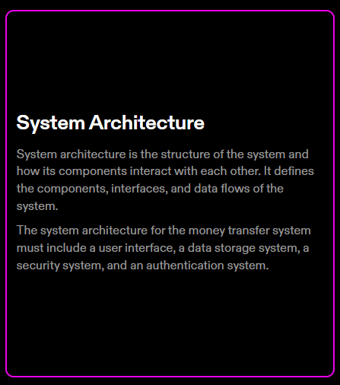

Slide 18

Security Requirements
A user password used for login must have a bit-strength of at least 64 bits. A user password used for login must be changed every three months. A user shall only be able to log into one at any given instance of time. A user that attempts to log into a second while already logged into

Slide 19

Safety Requirements
The system shall log every state and state change of every surface computer, tablet and display to provision recovery from system failure. The system shall be capable of restoring itself to its previous state in the event of failure(e.g. a system crash or power loss).The system shall be able to display a menu at all times to facilitate manual order taking should the need arise. The system shall utilise periodic 30-second keep-alive messages between tablets and the server to monitor tablet operational status

Slide 20

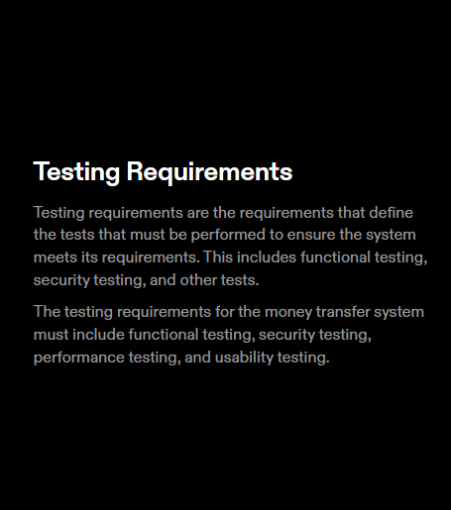

Slide 21
Submission Github
https://github.com/gokulkrish2003/srs-money-transfer-website.git

